Slide 1
ENERGY,
TYPES OF ENERGY
and
TRANSFER OF ENERGY

Slide 2
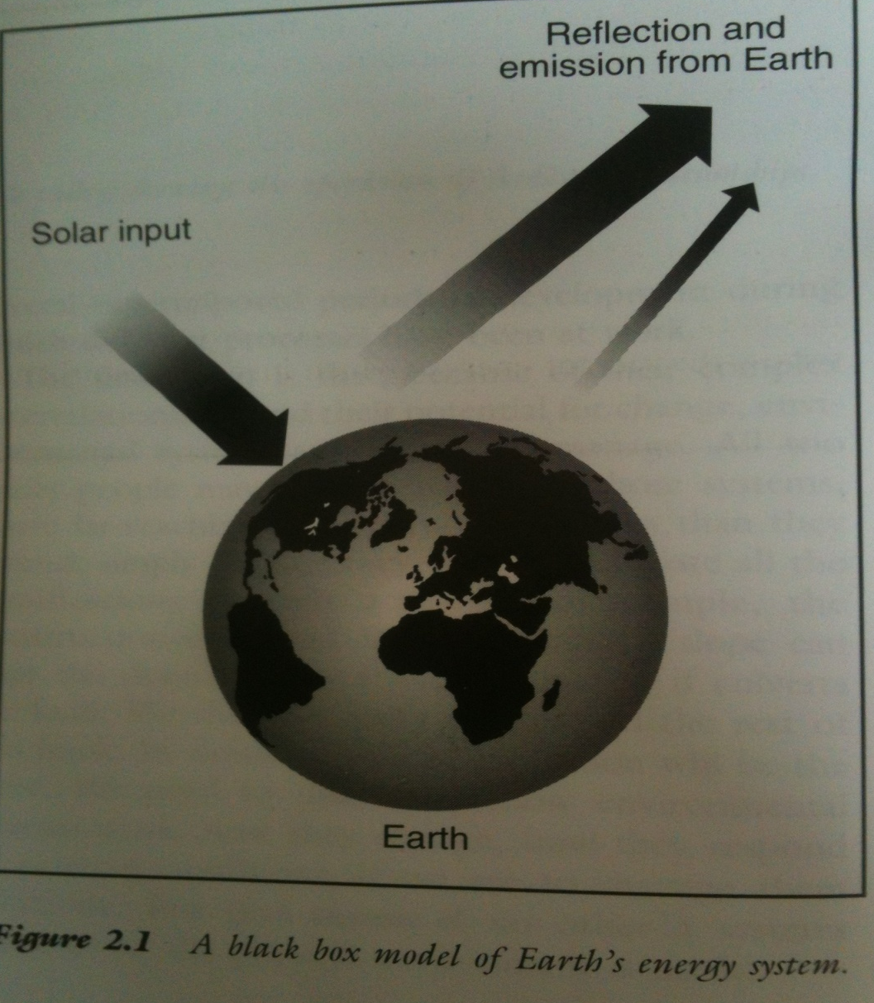
Balck box model of Earth,s energy system

Slide 3
Energy
Energy
is the capacity for doing work. You must have energy to accomplish work .To do 100 joules of work, you must expend 100 joules of energy.
Work
refers to an activity involving a force and movement in the directon of the force. A force of 20 newtons pushing an object 5 meters in the direction of the force. How much of work?
W= FxD
Power
is the rate of doing work or the rate of using energy, which are numerically the same. If you do 100 joules of work in one second (using 100 joules of energy), the power is 100 watts.
Newton: It is equal to the amount of net force required to acceleratate a mass of one kilogram at a rate of one meter per second squared.
Joule: It is equal to the energy expended (or work done) in applying a force of one newton through a distance of one metre

Slide 4
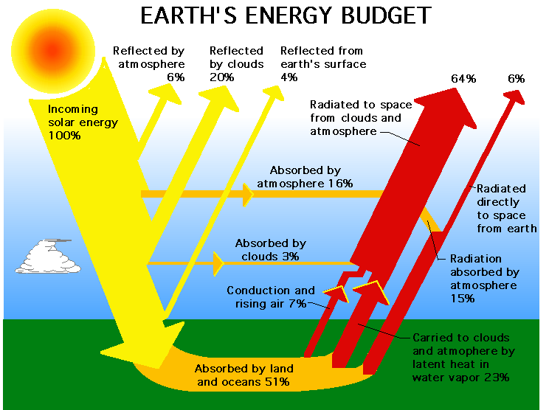
Heat (heat energy) is the total kinetic energy of all the atoms in a substance.
"radiation budget". Balance b/w energy reach earth and energy emitted to space
The energy coming from the Sun to the Earth's surface is called solar insolation or shortwave energy.
The temperature of the Sun's radiating surface, or photosphere, is more than 5500 degree C (9900 degree F).
Energy goes back to space from the Earth system in two ways: reflection and emission.
Reflection:
The percentage of solar energy that is reflected back to space is called the albedo.
Different surfaces have different albedos. Over the whole surface of the Earth, about 30 percent of incoming solar energy is reflected back to space.
  Ocean surfaces (26% albedo) and rain forests (15% albedo)
  Deserts have high albedos (40%); they reflect a large portion of the Sun's energy.
Emission:
Another part of the energy going back to space from the Earth is the longwave radiation emitted by the Earth. The solar radiation absorbed by the Earth increases the planet's temperature. Heat energy is emitted into space, creating a balance.

Slide 5
(1) --------------------------------------
(2)------------------------
(3)---------------------------------------
Incoming solar energy
100 %
(4)---------------------------------------
(5)---------------------------------------
(6)---------------------------------------
(9)---------------------------------------------
(7)---------------------------------------
(10)----------------------------------------------------------------
(8)---------------------------------------

Slide 6
Types of Energy
KE (kinetic energy)
PE (potential energy)

Slide 7
Forms of energy
Mechanical
Heat/Thermal
Chemical
Electrical
Electromagnetic
Nuclear

Slide 8
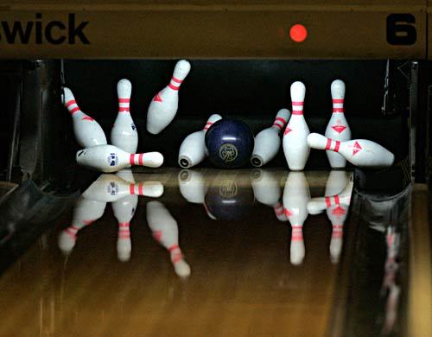
What is Mechanical Energy?
Energy due to a object’s motion (kinetic) or position (potential).
The bowling ball has mechanical energy.
When the ball strikes the pins, mechanical energy is transferred to the pins!

Slide 9
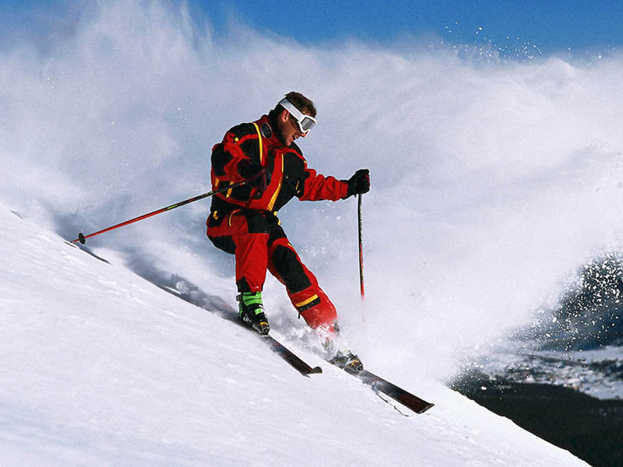
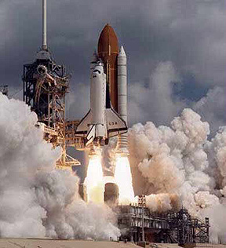

Examples of Mechanical Energy

Slide 10

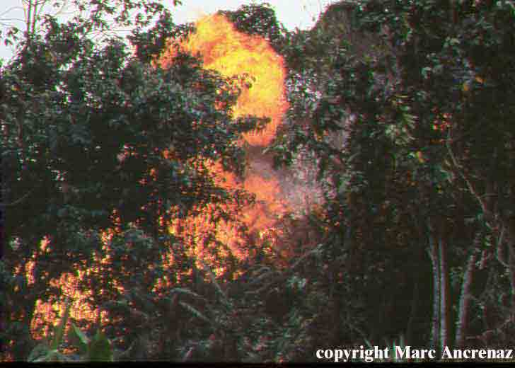
Heat/Thermal Energy
The internal motion of an object atoms and molecules.
Measured by temperature.
Temperature and heat?
The faster particles move, the more thermal energy they have.
KE only

Slide 11
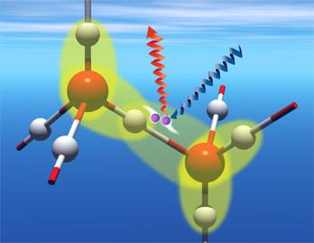
Chemical Energy
Energy stored by chemical bonds in an object.
When bonds are broken energy is released.
PE only
gasoline, food, coal, wood

Slide 12
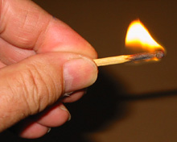
What is Chemical Energy?
Energy that is available for release from chemical reactions.
The chemical bonds in a matchstick store energy that is transformed into thermal energy when the match is struck.

Slide 13
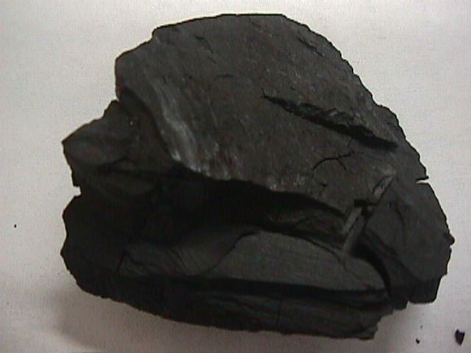
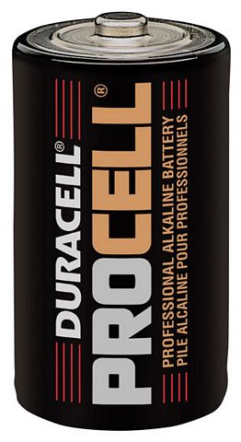
Examples of Chemical Energy

Slide 14
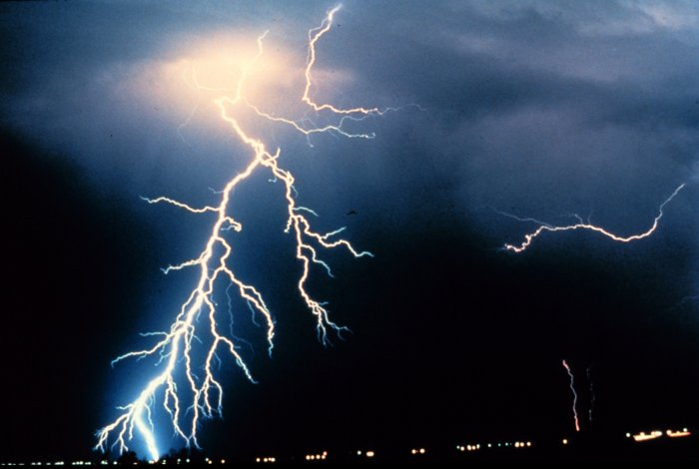
Electrical Energy
Moving electrical charges.
Electricity from batteries, power lines, lightning
KE

Slide 15
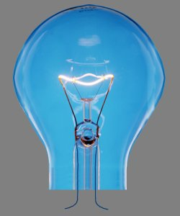
Electromagnetic Energy
energy that travels in waves; have electrical and magnetic properties
Light, Magnetism, X-Rays, Radio waves, microwaves, ultraviolent and infrared radiation
KE

Slide 16
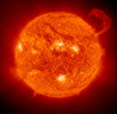
Nuclear Energy
Energy stored in center(nucleus) of an atom
Fission (breaking apart)
Fusion (forming)
The sun
Most powerful
PE only

